Slide 1
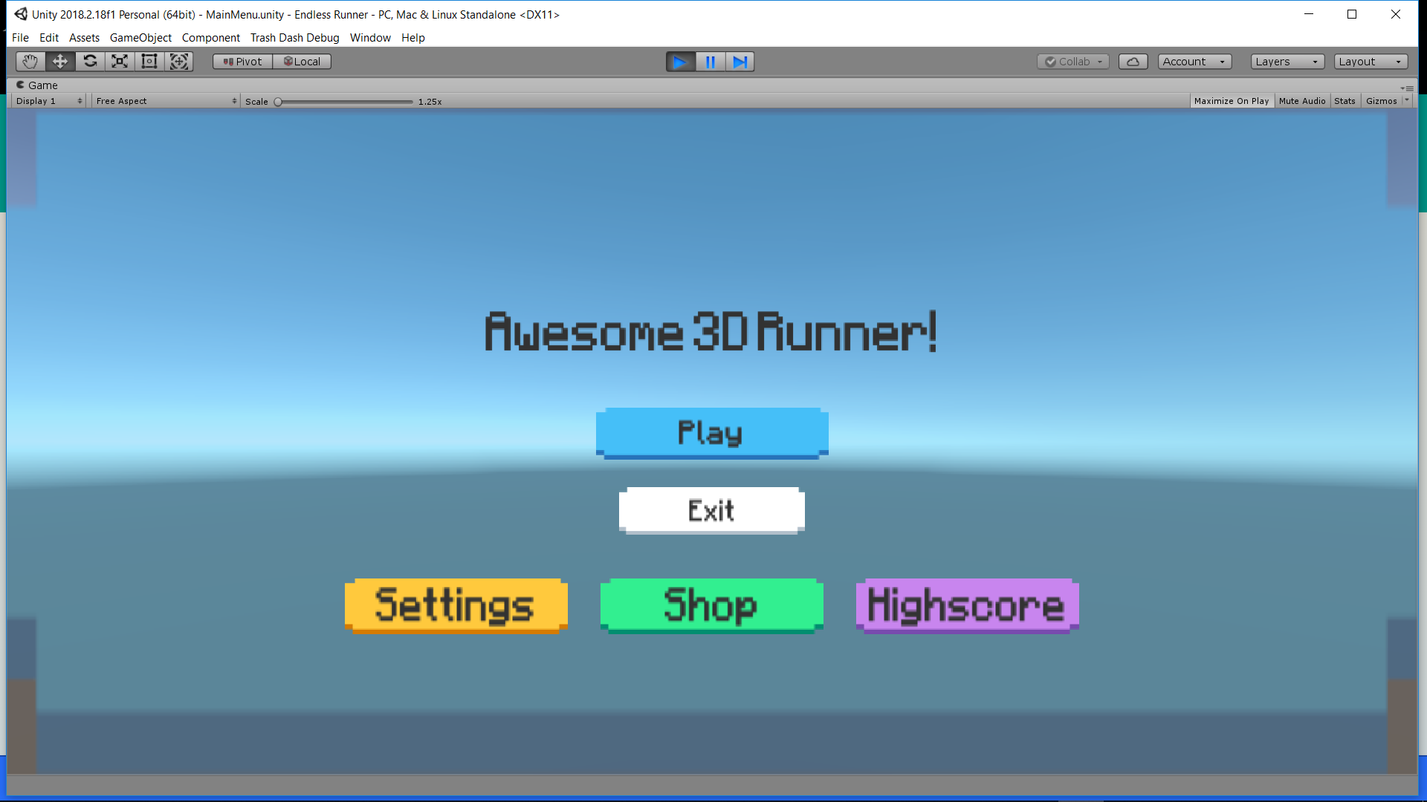
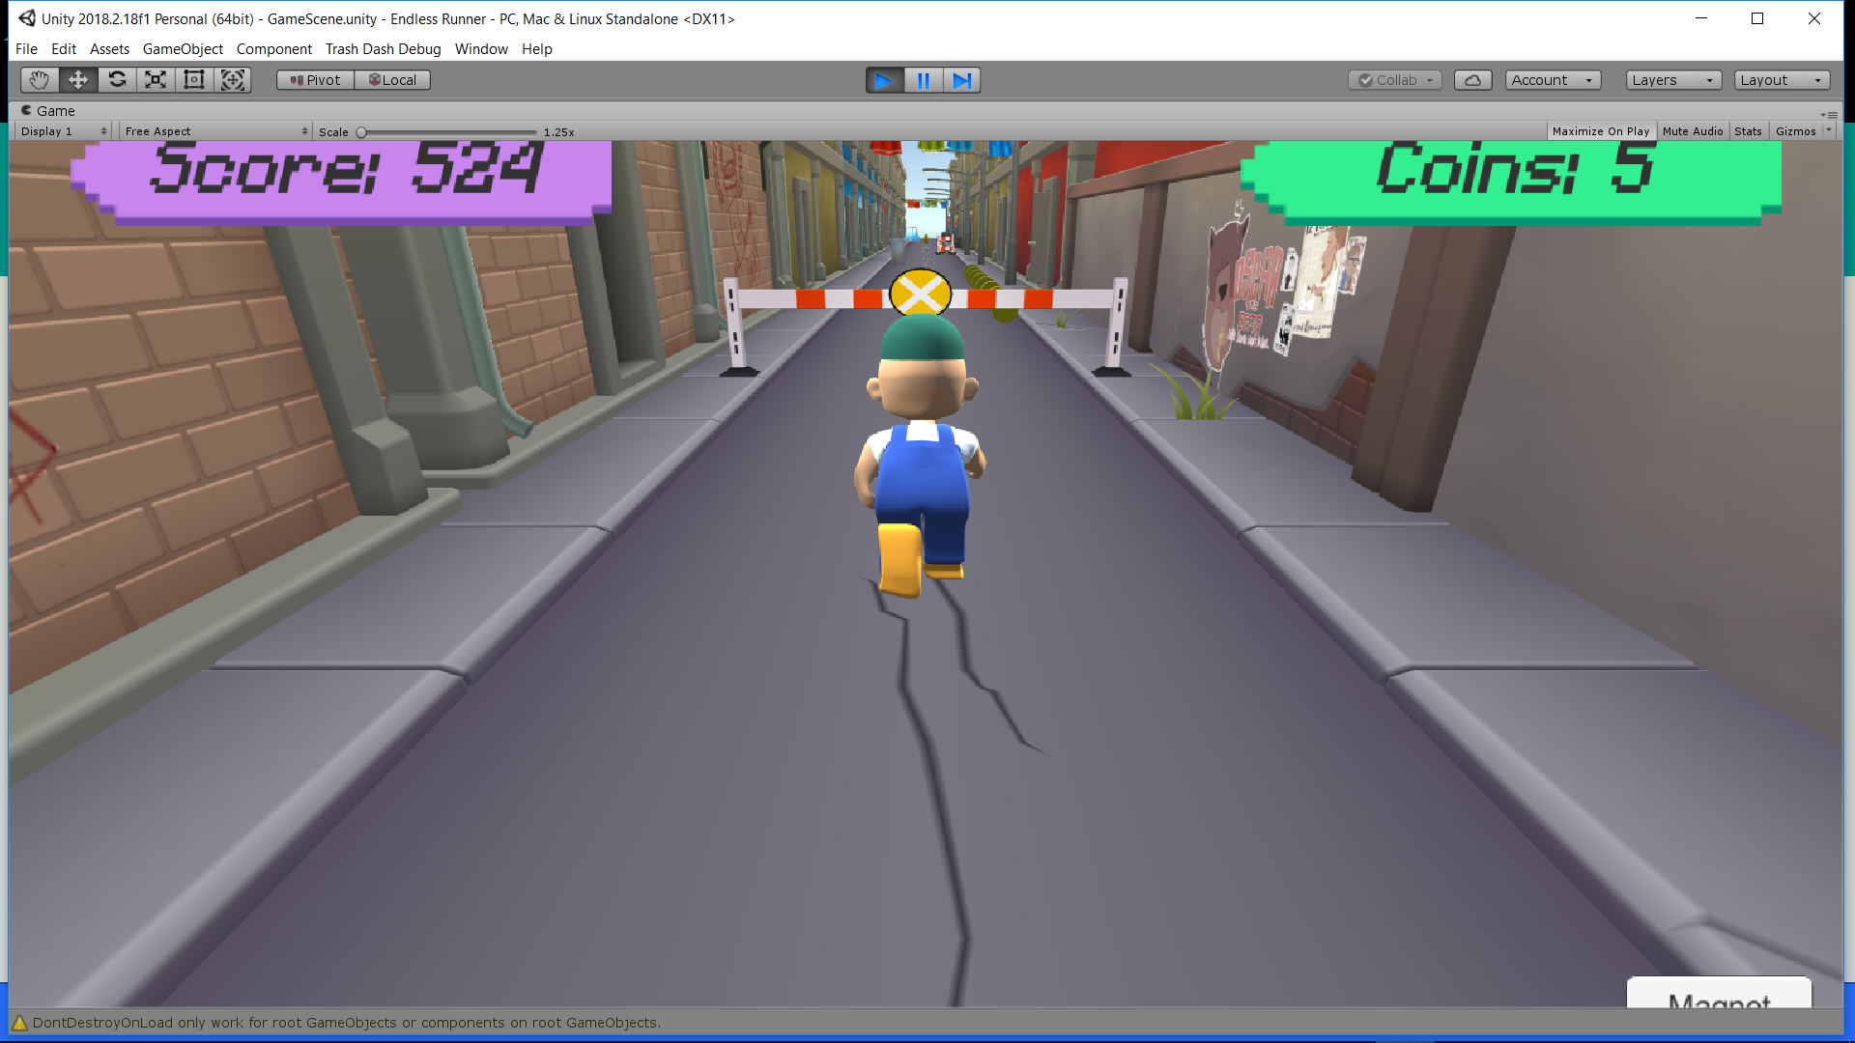
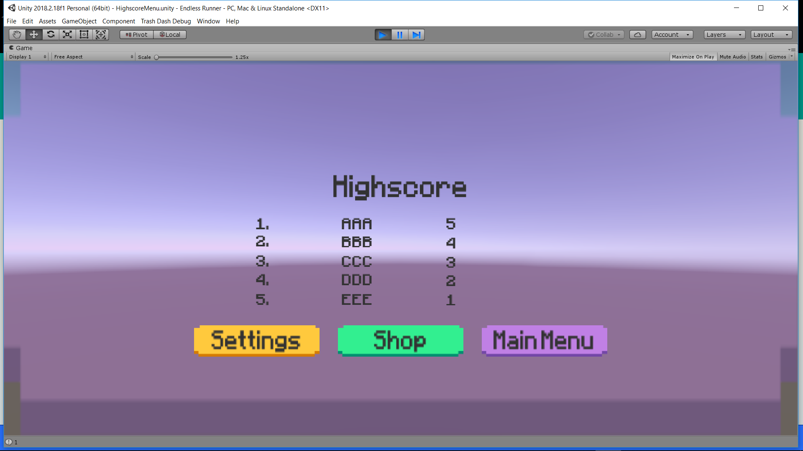
Endless runner
Fares Khattab, Patrick O’Connor, Oubine Perrin, Shane Gannor
Oulu University of Applied Sciences, Information Technology
Introduction
The subject of this project was to design and create a game. To do so, we used Unity game engine. The main purpose was to make an endless runner game in which the player character is continuously moving forward trying to avoid obstacles. This is possible by making the character perform some special actions.
FIGURE 1. Basic design of the project
Objective:
The final objective of this project was to have a character that runs in a 3-Lane track and can jump, slide, move right, move left in order to avoid the traps. The player accelerates progressively and the environment is darker the further he is. Also, the player is able to collect coins to increase the score.
Methods
The whole game functionalities are written in c# (the language used for unity). We also used Blender which is an open-source 3D computer graphics software that allowed us to create the character for the game and also we imported assets from the AssetStore for the design of the game.
FIGURE 2. Batteries connected in serial
Results
We did manage almost to completely finish the game. We have:
Terrain (3 Line track the player will run on).
Traps and coins.
Menu of the game(Main menu, settings menu,shop,highscore..)
Player model
Progressive speed increase
Skybox and lightening
Displaying score and coins.
Background music
FIGURE 3. a closer look of ADG42
Conclusions
This project was very interesting. We learnt a lot about unity and we find it very cool because we love video games.
References
https://unity3d.com/
Project work
ECTS credits: 15
Date of publication: 2018, Autumn
Supervisor: Pertti Heikkilä

